Slide 1
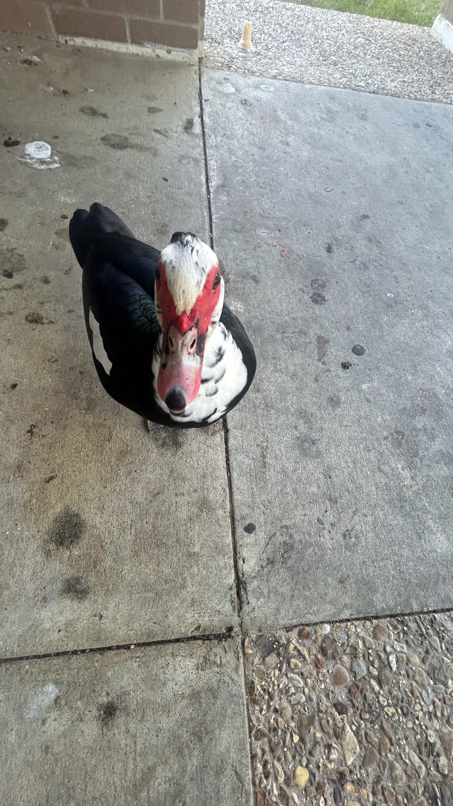
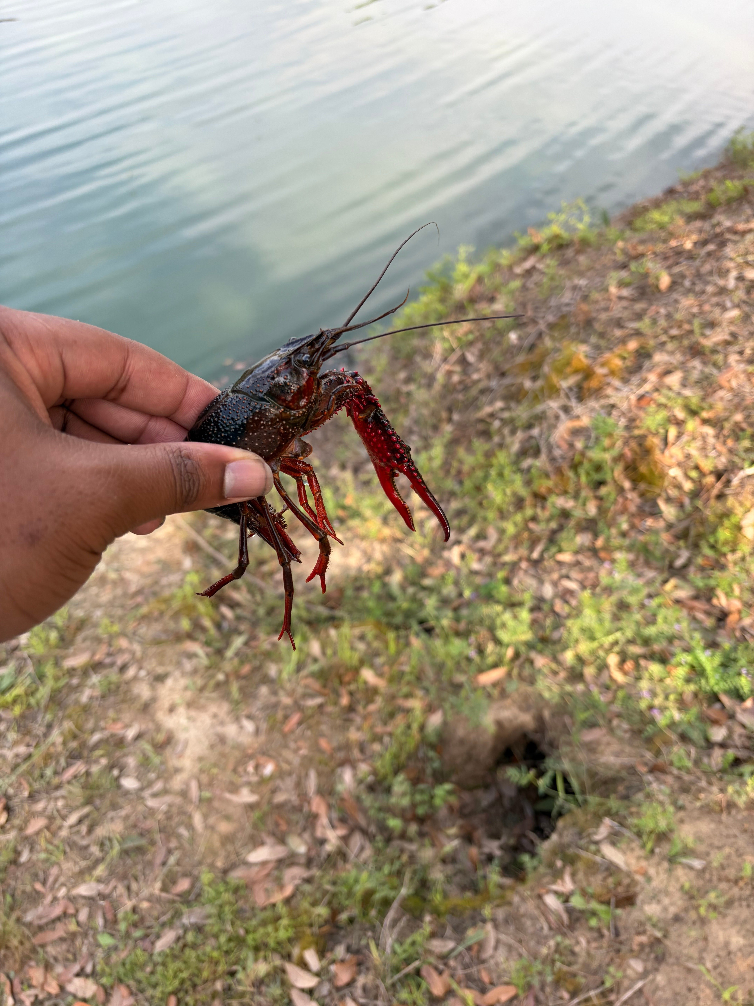
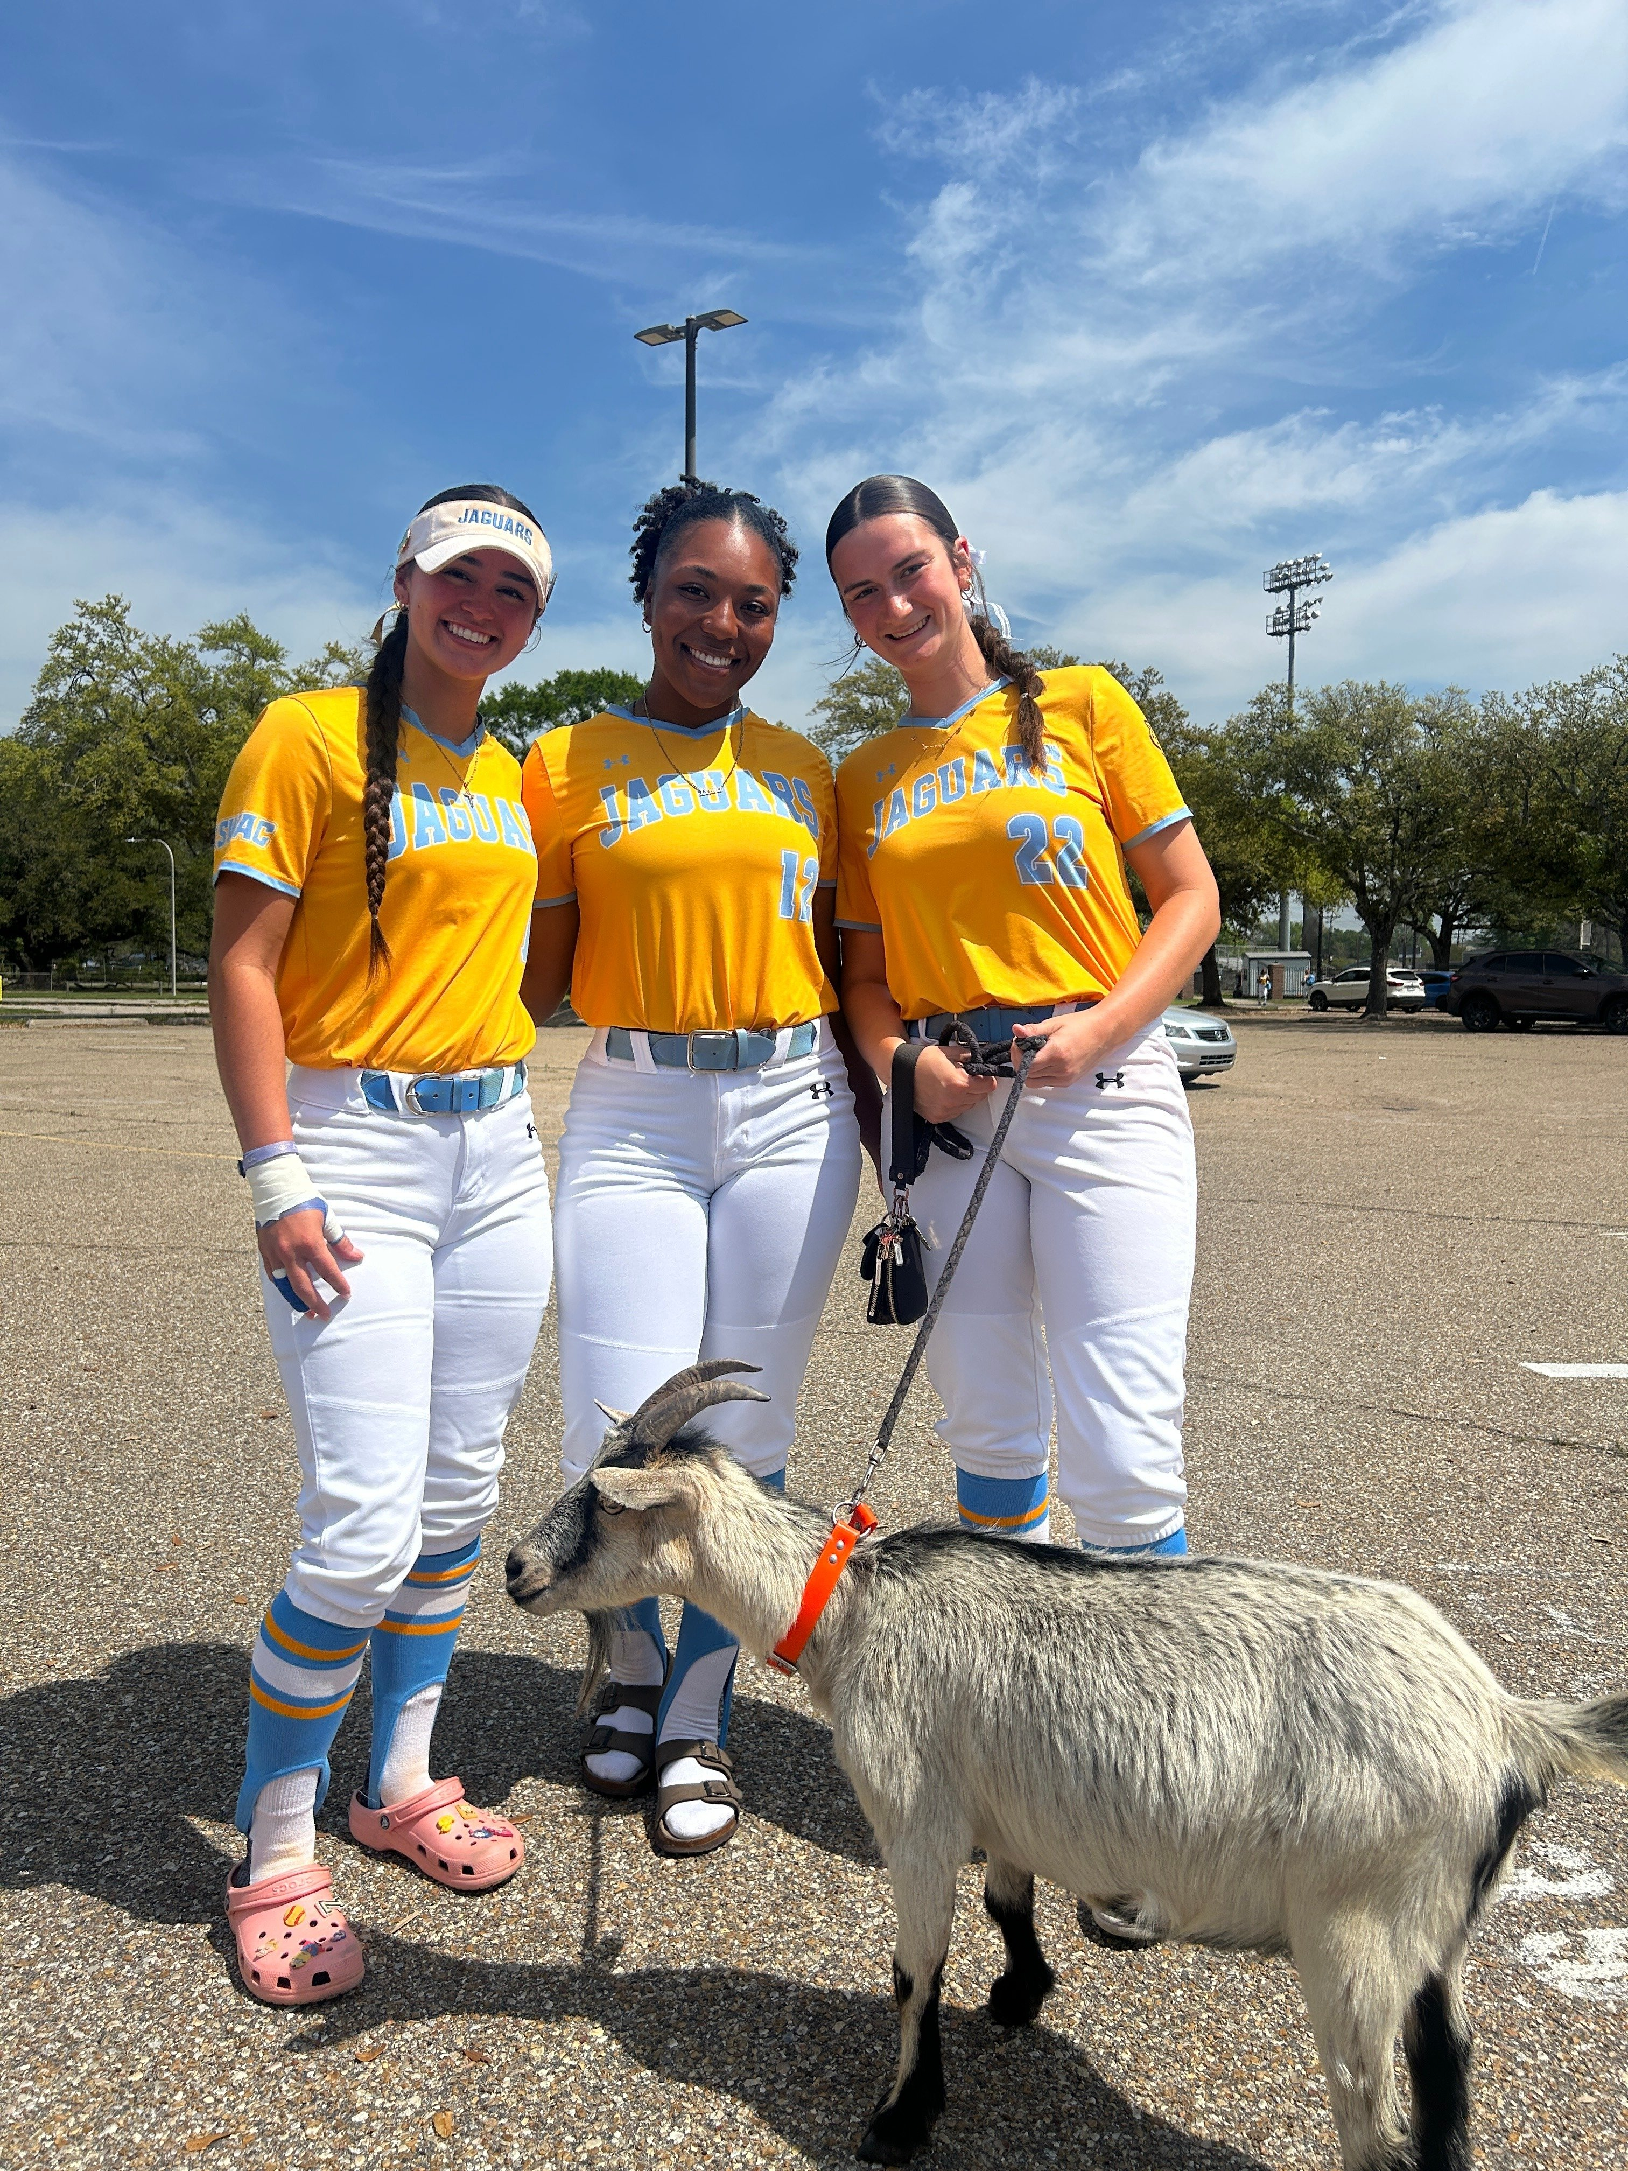
SBIO 102B · Module 3 Portfolio Entry
Campus Wildlife
Survival Profile
Muscovy Duck
Animal Physiology, Adaptation & Digestion
[Student Name] · Southern University A&M College
Red Swamp Crawfish
[Instructor Name] · April 2025
Pygmy Goat

Slide 2
Overview
Module 3 · Animal Physiology & Adaptation
🦆 Muscovy Duck
🦞 Red Swamp
Crawfish
🐐 Pygmy Goat
Cairina moschata
Procambarus clarkii
Capra aegagrus hircus
Thermoregulation
via caruncles
Exoskeleton -
desiccation resistance
Ruminant stomach
(4 chambers)
Waterproof plumage
Gill + air breathing
Panting & sweating
Lamellate bill
(filter feeding)
Chelipeds for
omnivorous feeding
Concentrated urine
(water conservation)
Southern University A&M College · SBIO 102B · Module 3

Slide 3
Animal 1 — Muscovy Duck
Cairina moschata · Observed on campus sidewalk, Southern University A&M College
1
Caruncles (Red Facial Skin)
Richly vascularized red facial skin radiates excess body heat , acting like a radiator for thermoregulation in Louisiana's heat. Classic peripheral vasodilation.
2
Waterproof Plumage
Preen-gland oil coats feathers, preventing soaking. Maintains thermal insulation and water balance even when wet , key homeostatic function in a humid climate.
3
Lamellate Bill - Digestive Adaptation
Comb-like plates (lamellae) filter algae, invertebrates, and detritus from water , an omnivorous digestive adaptation enabling flexible foraging in a human-altered environment.
Figure 1: Muscovy Duck on campus sidewalk — SU A&M College

Slide 4
Animal 2 — Red Swamp Crawfish
Procambarus clarkii · Caught near campus waterway — a Louisiana ecological & culinary icon
1
Chitinous Exoskeleton
Hard shell prevents water loss through the body wall , critical for surviving Louisiana's seasonal droughts when crawfish burrow into mud. Behavioral + physiological homeostasis combined.
2
Gill + Air-Breathing Ability
Feathery gills extract dissolved O₂ from water. Moist gill surfaces also allow brief air-breathing while burrowing, flexibility for fluctuating wetland O₂ levels linked to algal blooms (Module 2).
3
Large Chelipeds — Omnivorous Feeding
Enlarged claws capture and process plant matter, detritus, and invertebrates. As detritivores, crawfish feed on the very algae documented in the campus pond in Module 2, connecting organism to ecosystem.
Figure 2: Red Swamp Crawfish near campus waterway

Slide 5
Animal 3 — Pygmy Goat
Capra aegagrus hircus · With SU Jaguars softball players — campus community connection
1
4-Chamber Ruminant Stomach
Rumen, reticulum, omasum and abamasum enable the fermentation of the microbes in breaking down cellulose, a substance that can not be digested by most mammals. Gathers as much energy as possible in the variable climate of Louisiana on fibrous vegetation.
2
Panting & Sweating - Evaporative Cooling
Goats control the body temperature by sweating the skin and respiratory evaporation (panting). These combined ensure humid Louisiana summers are maintained in homeostasis, as is expected with climate issues as plotted in Module 2.
3
Concentrated Urine - Osmoregulation
The kidneys are highly efficient as they focus on urine and save water to preserve fluid and electrolyte balance and reduce frequent drinking. A traditional type of renal homeostatic system adapted to warm and seasonally dry conditions.
Figure 3: Pygmy Goat with SU Jaguars softball team

Slide 6
Adaptations at a Glance
Summary of physiological adaptations supporting homeostasis
Species | Adaptation | Homeostatic Function
Muscovy Duck | Vascularized caruncles | Heat dissipation / thermoregulation
Muscovy Duck | Oily waterproof feathers | Insulation & water balance
Muscovy Duck | Lamellate bill | Omnivorous filter feeding
Red Swamp Crawfish | Chitinous exoskeleton | Water retention / desiccation resistance
Red Swamp Crawfish | Gill + air-breathing | Gas exchange in fluctuating O2 environments
Red Swamp Crawfish | Large chelipeds | Omnivorous feeding / detritivory
Pygmy Goat | 4-chamber ruminant stomach | Cellulose digestion / energy extraction
Pygmy Goat | Panting + sweating | Evaporative cooling in humid heat
Pygmy Goat | Concentrated urine production | Water conservation / osmoregulation

Slide 7
Connection to Previous Entries
How Module 3 builds on the campus pond ecosystem from Modules 1 & 2
The ecosystem that I mapped in Module 2 affects the physiology of these species due to the warm and nutrient-saturated water, seasonal changes in oxygen levels, and seasonal changes in temperature of the campus pond that pose the precise selection pressures that result in the thermoregulatory, digestive, and respiratory adaptations described above.
Module 1
Module 2
Module 3
Algae Population
Pond Ecosystem & Climate Risk
Organism Physiology
The algae in the campus pond were recognized to be an independent population. In Module 3, however, that algae is the food source of the crawfish detritivorous diet.
The identified risk or physiological challenge that the crawfish and duck are adapted to overcome is the climate-driven eutrophication (algal blooms, low O 2) that was detected in the Module 2.
Ecosystem to organism zoom: What are the ways in which individual animals can be in homeostasis in the selective pressures of this particular HBCU campus setting?
Southern University A&M College · SBIO 102B · Module 3

Slide 8
Key Takeaways
Module 3 · Animal Physiology, Adaptation & Digestion
🌡️
Homeostasis is maintained through multiple physiological systems working together , thermoregulation, digestion, and osmoregulation are not isolated.
🔗
Campus species are directly connected to the pond ecosystem from Modules 1 & 2 , the same algae, the same water, the same climate stressors.
🏛️
Biology is alive at Southern University A&M College , from the duck on the sidewalk to the crawfish in the waterway, adaptations are everywhere on campus.
🧑‍🔬
Understanding these adaptations helps predict which species are most vulnerable to climate change , a theme that will continue into future modules.

