Slide 1
Classroom management
(Draft)
Letrica Parker
Coppin State University
EDUC 454 Classroom Management
Dr. Weisburger
Notes:
Hello everyone, my name is Letrica Parker, and today, I am going to present my Classroom Management Plan that is aimed at a Head Start early childhood classroom; developing a well structured, supportive, and engaging classroom learning environment among young children. I am going to guide you through my grade level, philosophy, classroom arrangement, rules, strategies and how I encourage student behavior.

Slide 2
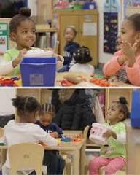
Grade Level
Head Start Classroom (Ages 3–5)
Early Childhood / Preschool
Diverse learners (language, developmental, cultural differences)
Focus: school readiness, social-emotional growth
Notes:
My classroom is a Head Start preschool classroom which has children of age 3-5 years. This is the time when the students are almost forming their social, emotional, and communication skills and therefore classroom management should be very deliberate and conducive. There are different learners in the classroom, such as English language learners and learners with various developmental requirements. “A properly structured classroom atmosphere and good teacher-child relationships play a big role in the enhancement of behavior and involvement (Weinstein, 2022). Due to this, my management philosophy is concerned with establishing school preparedness, autonomy and good social relations.

Slide 3
Classroom Management Philosophy
“My classroom management philosophy is based on Developmentally Appropriate Practice and PBIS, which stands for Positive Behavioral Interventions and Supports.
Instead of focusing on punishment, I focus on teaching students the behaviors I expect to see. This includes building strong relationships, maintaining consistency, and clearly teaching routines and expectations.
The main goal is to prevent behavioral issues before they happen by creating a predictable and supportive environment.”
Notes:
The philosophy of my classroom management is Developmentally Appropriate Practice and PBIS, which abbreviates to Positive Behavioral Interventions and Supports. I do not emphasize punishment, but on teaching students how I want them to behave. This involves developing good relationships, consistency and ensuring that routines and expectations are clearly taught.
The primary objective is to avoid behavioral problems prior to their occurrence by establishing a predictable and conducive environment.

Slide 4
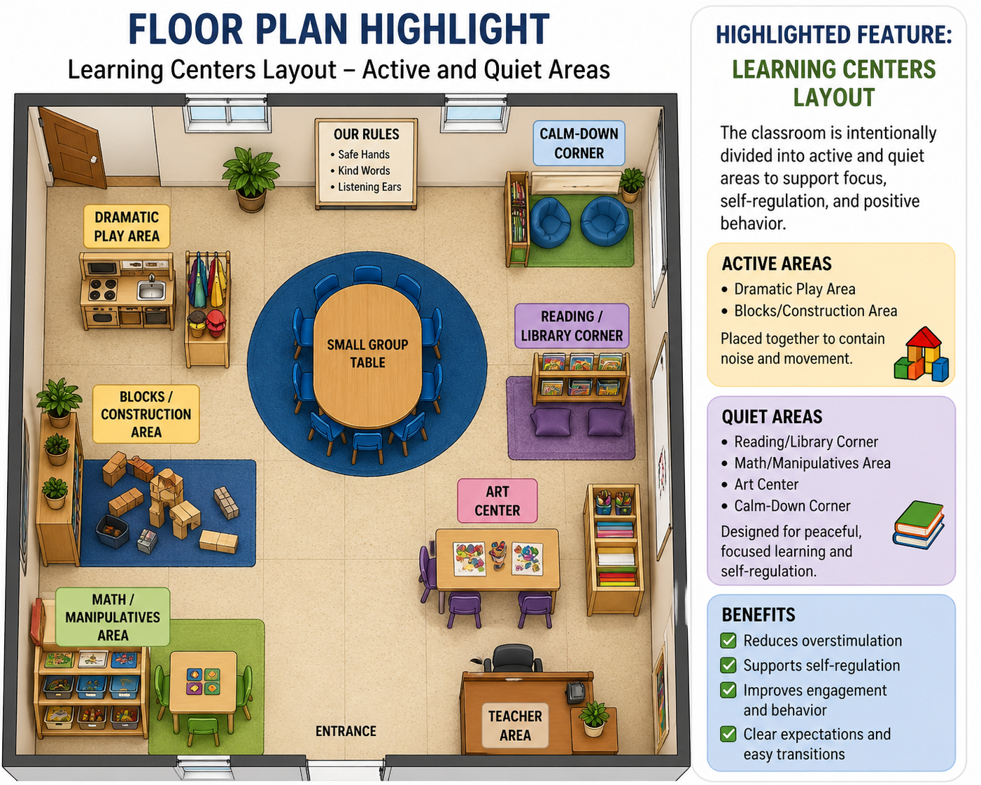
Floor Plan Highlight
Feature: Learning Centers Layout
Classroom divided into active & quiet areas
Examples:
  Active: Blocks, Dramatic Play
  Quiet: Reading Corner
Benefits:
  Reduces overstimulation
  Supports self-regulation
  Improves focus & behavior
Notes:
The learning centers are a vital aspect of my classroom. The classroom is separated into active and quiet areas. Examples include having stronger spaces such as blocks and dramatic play in the same location and a separate location for the softer spaces such as resting and the reading corner. Such arrangement assists in minimizing noise and overstimulation which is very critical to young children. It also facilitates self-regulation and enables the students to devote more attention to their activities.

Slide 5
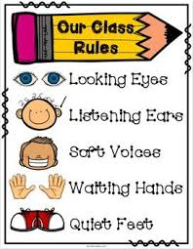
Classroom Rules
(Simple & positive)
Safe hands
Kind words
Listening ears
Taught using:
  Modeling
  Visuals
  Practice & repetition
Notes:
My classroom rules are uncomplicated, affirmative and simple to memorize by young children. The three primary principles are: kind words, safe hands and listening ears.These rules are not merely put up but they are taught. I employ modeling, images, songs, and practice to make students learn and remember them.With simplicity and consistency in rules, students would tend to obey rules throughout the day.

Slide 6
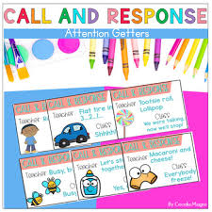
Consequences (Whole Class)
Attention signal (clap or call-response)
Group reteaching of expectations
Short-term loss of privilege (center closed)
Calm-down break
Purpose: Teach, not punish
Notes:
In whole-class management, I employ non-punitive, corrective strategies. I can give an example of attention cues such as clapping patterns that I employ in order to concentrate. I will stop and remind the entire group of expectations should it be necessary to do so. There are occasions when a center might close at a time when materials are not properly being utilized. I can also take brief relaxation breaks to enable students to reappear. These consequences are always meant to educate and instruct at the behavior not to rebuke the students.

Slide 7

Consequences (Individual)
Verbal reminder
Choice-based redirection
Temporary loss of center
Guided reflection
Focus: Help student learn correct behavior
Notes:
I employ more individual strategies to individual students.This can begin with a mere oral reminder of the rule. On demand, I offer options, e.g., to move on in a proper manner or to have a short break.Other practices involve temporarily taking a student out of the centre or putting one in to go through reflection to know their behavior. These plans assist students to become responsible and gain self-control.

Slide 8
Positive, Proactive, Preventative Strategies
Positive: Praise & relationships
Proactive: Teach expectations ahead of time
Preventative:
Structured routines
Visual schedules
Organized environment
Goal: Stop problems before they start
Notes:
My classroom management is anchored on three major concepts namely positive, proactive, and preventative strategies. Positive Conditions Positive means I tend to concentrate on encouraging positive behaviour and establishing a good rapport with students. Proactive implies that I present expectations when things start, so the students are informed of the expectations. Preventative: I make timetables, draw visual charts and plan the classroom to minimize confusion and eliminate behavior problems. These strategies, when combined form a learning atmosphere that is conducive and relaxing.

Slide 9

Meeting Individual Student Needs
Example:
Student struggling with behavior
Support includes:
  Visual cues
  Calm-down area
  Behavior contract
  Positive reinforcement (stickers/rewards)
Notes:
I offer specific intervention to meet the needs of individual students. As an example, I may apply visual aids, peaceful zone, or behavior contract whereby a student has an issue of behavior. I also practice positive reinforcement, like sticker chart or praise, to promote the correct behavior. These helps are aimed at assisting every child to excel depending on his or her needs.

Slide 10
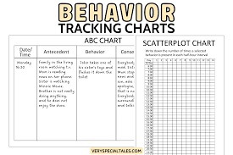
Additional Strategy
Data Tracking System
Tools:
  Behavior checklists
  ABC charts (Antecedent-Behavior-Consequence)
Purpose:
  Identify patterns
  Adjust teaching strategies
  Support student success
Notes:
Another strategy that I employ is data tracking. I gather data with the help of such tools as behavior checklists and ABC charts, which trace what occurs before and after a behavior. This assists me to determine patterns and reasons behind behaviours occurring. With this information, I will be able to modify my teaching practices and support my students in a more effective way.

Slide 11
References
Archer, A. L., & Hughes, C. A. (2011). Explicit Instruction: Effective and Efficient Teaching. The Guilford Press.
McIntosh, K. (2023). Schoolwide positive behavioural interventions and supports and human rights: Transforming our educational systems into levers for social justice. International Journal of Developmental Disabilities, 69(1), 5–12. https://doi.org/10.1080/20473869.2022.2116223
Sun, Y., Blewitt, C., Minson, V., Bajayo, R., Cameron, L., & Skouteris, H. (2024). Trauma-informed Interventions in Early Childhood Education and Care Settings: A Scoping Review. Trauma, Violence & Abuse, 25(1), 648–662. https://doi.org/10.1177/15248380231162967
Weinstein, C. S. (2022). Elementary Classroom Management: Lessons from Research and Practice. McGraw-Hill Higher Education.
Xie, S., & Li, H. (2022). Self-regulation mediates the relations between family factors and preschool readiness. Early Childhood Research Quarterly, 59, 32–43. https://doi.org/10.1016/j.ecresq.2021.10.005

