Slide 1
Left Behind While Moving Forward: Exploring the Impact of Grade Level Promotion on Chronically Failing Students in Urban Schools
Name of the Student
Name of the Institution
Course Code
Name of the Instructor
Date

Slide 2
Introduction and Background
The Problem
Many students in urban schools are promoted despite repeatedly failing key subjects.
This further causes academic gaps and emotional strain in the long run.
Why This Must Be Studied
Promotion conceals the plight of students rather than facing them.
Failure is internalized without intervention and disengagement is experienced.
Urban Middle Schools
Schools that are under-resourced do not have the capacity to provide individual support (López et al., 2021).
Promotion comes to be a default policy rather than a strategy of learning (Resende & Petterini, 2021).
Study Context
This study was conducted in one urban public middle school in a socioeconomically disadvantaged district.
Notes:
This study looks at a common problem in urban schools. Students are being promoted consistently as they continue to fail important subjects. In the long run, this results in a greater learning disparity and also in emotional strains. The struggle cannot be solved, but can be covered by promotion. Students can begin to think that failure is a part of their personality and can check out. For example, a student who still struggles with basic reading is promoted, then faces harder texts and stops raising their hand because they feel embarrassed. In urban middle schools, the resources are not as abundant, and staff members are not always able to provide individual support (López et al., 2021). In such environments, promotion as a policy might replace the learning strategy (Resende & Petterini, 2021). That is why the problem needs to be researched. This study took place in a single urban middle school of a socioeconomically disadvantaged district. The aim is to get more enlightenment about the academic and emotional effects of promotion, to enable schools to be more responsive and realistic.

Slide 3
Core Problem and Key Constructs
Chronic Academic Failure
Students are repeatedly promoted despite failing essential subjects.
These patterns reflect systemic barriers, not a lack of effort (Cartwright et al., 2023).
Educator Constraints and Student Identity
Educational staff and school counselors are pressured to adhere to policy on behalf of student needs (Bitarafan et al., 2024).
Unprepared promotion is damaging to confidence and learning identity (Zhang and Huang, 2022).
Why Qualitative Action Research
Qualitative methods assist in examining emotions, meanings and real world experience of school.
This strategy involves listening to the opinions of the most directly affected persons, such as students and teachers.
Notes:
This slide describes the main concepts of the study. Two key concepts are described in this slide. The first is chronic academic failure. There are also some students who continue to fail major subjects, yet they are promoted to the next grade. This usually occurs due to problems with the school system, as opposed to students not trying. Cartwright and colleagues (2023) argue that repeated failure can be caused by barriers such as big classes, inadequate support programs, and lessons that are not aligned with the students' needs. The second concept is teacher boundaries and learner identity. A student may be known to be not ready by the teachers and school counselors, but it is mandatory to adhere to district regulations. Bitarafan and colleagues (2024) explain how a push of the policy can hinder staff in performing what they consider to be the best. Examples include a teacher desiring tutoring or more time before being promoted, yet the student is promoted. In the long run, according to Zhang and Huang (2022), this may damage confidence and lead to the students feeling incapable of learning. This makes the action research of the study qualitative in order to listen to actual experience.

Slide 4
Research Questions
RQ1: What happens to the life experiences of chronically failing urban middle school students in Grades 6–8 who are socially promoted from one grade to the next?
Examines students’ lived academic and emotional experiences after promotion, including how they describe coping with learning gaps across grades.
RQ2: What are the perceptions of social promotion on student learning and motivation by teachers and school counselors?
Examines how teachers and counselors interpret student readiness, motivation, and classroom engagement after promotion, including perceived supports and challenges.
RQ3: What are the effects of grade level promotion on student engagement and future academic achievement?
Examines how promotion relates to ongoing participation in school and perceived impact on longer-term academic progress.
Notes:
This slide outlines three research questions that will be used to conduct the research. In the first part, the question is what life was like for those students in their Grade 6-8 who continue to fail but are promoted anyway. It examines school learning, feelings and how the students cope with gaps as they progress through grades. The second question inquires about how teachers and school counselors feel about social promotion and its influence on learning and motivation. It pays attention to what they observe with respect to readiness, effort and class involvement, and what (support) is lacking. The third question is what the impact of promotion on student engagement and subsequent achievement is. In plain language, we enquire of the students what they pass through, of the teachers what they observe and of what occurs with the passage of time. For example, when a student is promoted with a problem with reading, we want to know how it impacts the participation at present and performance in the future. These questions assist in creating a definite image of the problem.

Slide 5
LITERATURE REVIEW: STRUCTURAL BARRIERS, STUDENT IMPACT, AND EDUCATOR RESPONSES
Urban School Structural Barriers
Schools in poor neighborhoods are overloaded, understaffed, and underfunded (López et al., 2021).
Promotion vs. Retention Debate
Retention can reduce self-esteem and predispose to dropout (Goos et al., 2021).
Unsupported promotion can aggravate anxiety and increase academic gaps (Zhang and Huang, 2022).
Student Emotional Fallout
Chronic failure causes an active chronic stress and detachment (Beck et al., 2024).
Promotions without knowledge lead to misunderstandings and low self-esteem (Sousa et al., 2025).
Educator Roles and Constraints
Counselors foster belonging and help students believe in their academic ability (Tuxbury & Gibson, 2022).
Teachers face policy pressures that limit autonomy and decision-making (Byrne et al., 2022; Bitarafan et al., 2024).
Need for Responsive Interventions
One-size-fits-all reforms fail to meet diverse student needs (Kang et al., 2022).
Personalized support re-engages learners and improves long-term outcomes (Benson et al., 2022; Cartwright et al., 2023).
These barriers undermine instructional fit and do not allow interventions that are targeted (Christopher & Nesbitt, 2022).
Notes:
This slide describes the impact of students and school responses as indicated by research. Numerous urban schools experience these hurdles. They can be underfunded, understaffed, and overcrowded (Lopez et al., 2021). It is difficult to provide each student with the appropriate support due to this. According to Christopher and Nesbitt (2022), restricted intervention can lead to a gap in learning in the long run. The retention vs. promotion debate is also a confusing one. Goos et al. (2021) indicate that retention may cause damage to self-esteem and raise the chances of dropout. However, encouraging students without assistance may also be detrimental. This is linked with anxiety, especially when students are not able to uphold (Zhang & Huang, 2022). Beck et al. (2024) associate chronic failure with stress and school absence. According to Sousa et al. (2025), confusion and poor self-esteem are manifested in instances where students are advanced without having mastery. As an example, a student can give up attempting in the classroom due to the impossibility of the work. Such strain is likely to result in reduced cooperation in the classroom. According to Sousa et al. (2025), students usually become embarrassed and disoriented. These feelings demotivate and hinder identity as learners.
For example, imagine a classroom with one teacher and 30 students, with no full-time reading interventionist. Here, a student who failed to grasp the basics of phonics or comprehension in previous grades might not get the additional assistance needed to catch up. If such a student is held back, they might feel embarrassed to be older than another student. When that child is promoted without any encouragement, they might become demoralized by more difficult tasks and give up. In both events, the school's structural limitations determine the outcome. It is not a case of anxiety, silence, or withdrawal that the student experiences in isolation. It is linked to full classes, limited personnel, and non-consistent support of instruction over time.
In this part of the literature, it has been pointed out that even the educators are very much concerned with students, as well as severely restricted within institutional structures. The role of counselors is much broader than administrative. According to Tuxbury and Gibson (2022), they are beneficial in aiding students to recover a sense of belonging and academic self-efficacy. This emotional support is very crucial when students experience recurring academic failures. Teachers, in the meantime, are working under a lot of emotional and professional pressure. Byrne et al. (2022) state that the problem is that teachers usually want to ensure the development of students, but cannot take any action because of the policy restrictions. Such a limitation curtails their choice-making capacity in instructional issues. A study by Bitarafan et al. (2024) states that professionalism is disregarded, and educators feel powerless. The result of this kind of disconnection demoralizes and kills trust in the school administration. Kang et al. (2022) found that the strict reforms cannot be workable in other classes. This shows that flexibility and adaptability are needed. Finally, Benson et al. (2022) and Cartwright et al. (2023) both argue that individual assistance should be applied, which will re-engage learners and promote them in the long term.

Slide 6
Methodology: Action Research and Qualitative Design
Research Design and Rationale
The exploration of lived experiences is carried out using qualitative action research with a phenomenological focus (Thomas & Sohn, 2023).
This design will enable the study to seek out emotional, social, and academic complexity.
Why This Approach Fits
Action research gives educators power and focuses on problem solving at school (Bitarafan et al., 2024).
Phenomenology exposes individual meaning and internal reaction to more than statistics (Locke et al., 2022).
Setting and Participants
5 students, 7 teachers, 2 counselors, and 1 administrator from one urban middle school.
There is under-resource in the schools and students with a record of chronic academic struggle are served.
Sampling Method and Rationale
Criterion-based purposeful sampling was used to select participants with direct experience of social promotion (Schlunegger et al., 2024).
This method supported information-rich data by targeting stakeholders most able to describe the academic and emotional impact of promotion decisions (Schlunegger et al., 2024).
Notes:
This research will be a qualitative action research study, which is a phenomenological study. This aims to investigate lived experiences, rather than merely numbers. Qualitative action research assists in absorbing emotional, social, and academic intricacy (Thomas & Sohn, 2023). It also facilitates problem-solving in the school. Action research enables teachers to be empowered to reflect and contribute to solutions (Bitarafan et al., 2024). Phenomenology assists in exposing subjective significance as well as inside responses, as opposed to statistics (Locke et al., 2022). The context is a single under-resourced inner-city urban middle school with students who are showing chronic academic underachievement. The participants will consist of 5 students, 7 teachers, 2 counselors and 1 administrator. They are directly sampled by criterion-based purposeful sampling that selects individuals who have firsthand experience with social promotion (Schlunegger et al., 2024). For example, instead of only tracking test scores, a student can explain what it feels like to be promoted while still confused every day, and educators can describe what supports are missing and what might work.

Slide 7
Data Collection and Analysis
Semi-Structured Interviews
Ask students to talk about their personal experiences of failure, promotion, and their self-perception (Adeoye-Olatunde and Olenik, 2021).
The elastic format brings in emotional coloring and individual intuitions.
Observations and Focus Groups
A counselor and teachers consider student behaviors and systemic issues (Akyildiz, Ahmed, 2021).
Self-report patterns of engagement are observed in classrooms.
Thematic Analysis and Trust Measures
Thematic analysis aids in systematizing coding and developing patterns (Stuckey, 2018).
Member checking would provide accuracy; peer debriefing would generate trust (Schlunegger et al., 2024).
Action Planning Committee Role
Reviewed themes after thematic analysis and provided stakeholder sense-making and refinement.
Helped finalize the action plan/recommendations and supported validity through member checking/reflection.
Notes:
Data will be gathered in this research using semi-structured interviews and focus groups, as well as classroom observations. The methods are selected to reach various dimensions of experience. The students are conducted with semi-structured interviews since open discussion is possible. As described by Adeoye-Olatunde and Olenik (2021), the approach is practical when the researcher needs to investigate sensitive issues, including repetitive academic failure and emotional turmoil. Teachers and counselors are placed in focus groups to share common information concerning school practices. As Akyildiz and Ahmed (2021) observe, group discussions can bring out different patterns and issues that otherwise would not emerge in a one-on-one interview. Classroom observations provide an observation of student conduct. The observation of the interaction of students in real-time is the evidence that supports those interviewed. To analyze, thematic analysis will be done by thematic coding. Stuckey (2018) underlines that the tool assists in controlling and coding thick qualitative data. Member checking and peer debriefing will be applied to enhance the accuracy and reliability, as suggested by Schlunegger et al. (2024).

Slide 8
Implications of the Research
Empowering Educator Voice
Teachers and counselors can use findings to advocate for change in promotion policies.
Encourages more agency in supporting struggling students academically and emotionally.
Shaping Intervention Models
Results may inform new support systems for students at risk of failure.
Tailored strategies can be built around student needs, not policy shortcuts.
Influencing Equity Conversations
Study contributes to discussions on fairness and access in education.
Gives voice to students often left out of decision-making (Cartwright et al., 2023).
Notes:
The research will not only address a problem, but also practice and ethical considerations will be provided. The voice of the educator is one of such implications. The teachers and counselors have been forced to follow a rigid promotion policy, which is not grounded in what they observe in the classroom. This paper sheds light on the effects of such policies on the students and provides evidence that can be used by teachers in a way that can bring about policy change. The other implication is on intervention strategies. Schools can use the results to formulate support systems that address the academic, emotional, and social needs of the student, instead of determining whether to promote or not promote them. The presence of such supports is all the more effective when they are informed by first-hand experiences. Finally, the study contributes to the existing discussions of the issues of educational equity. Cartwright et al. (2023) are of the opinion that the front-line staff and students are unlikely to participate in the decision-making process. In this study, it is recommended that schools and policymakers should be more responsive by tapping more empathy, moral obligation and commitment to equity in the long term by concentrating their voices.

Slide 9
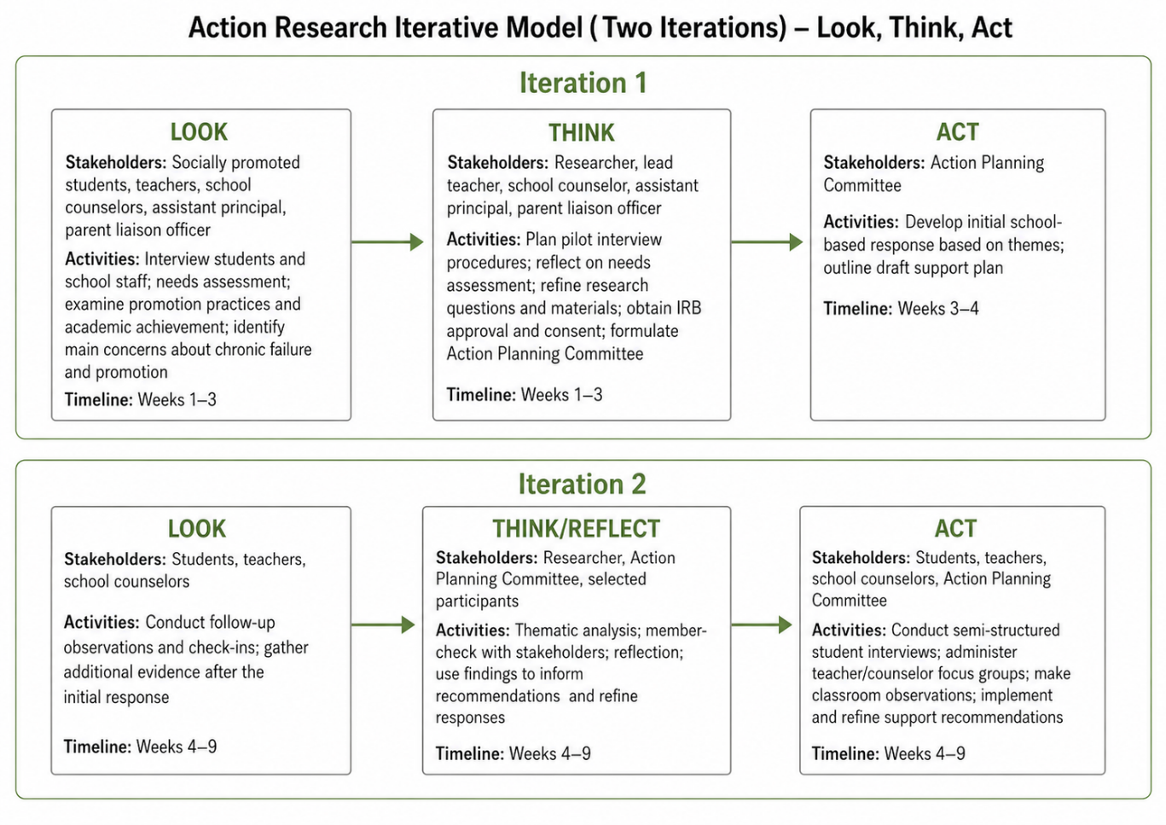
Action Research: Stringer’s Look, Think, Act Model
Notes:
This work follows the action research cycle presented by Stringer (2021), and it includes the following steps: Look, Think, and Act. Look stage is allocated to gathering first-hand data between students, teachers, and counselors. The research involves capturing what is going on in schools and documents this using interviews, focus groups and classroom observations. Iteration 1 involves the team first LOOKS. The stakeholders consist of the socially promoted students, teachers, school counselors, the assistant principal and a parent liaison officer. They interrogate students and school personnel, conduct a needs assessment, research promotion practices and achievement, to find the key areas of concern (Weeks 1-3). Next, they THINK. Stakeholders are the researchers, the teacher in charge, the school counselor, the assistant principal, and the parent liaison officer. They plan measures related to interviewing the pilot, filter the release of questions, obtain IRB approval and consent and create an Action Planning Committee (Weeks 1-3). Then they ACT. The committee will develop an initial school response and outline a draft plan of support (Weeks 3-4). In Iteration 2, they (LOOK) are revisited with follow-up observations and check-ins, (THINK/REFlect) through thematic analysis and member checks, and (ACT) through carrying out interviews, focus groups, classroom observations, and refining recommendations (Weeks 4 -9). For example, if "anxiety" appears in early data, the team tests a support plan and improves it after feedback.

Slide 10
Findings
Social Promotion Often Undermines Student Success
Promoting students without mastery leads to long-term learning gaps
Significant Emotional and Motivational Impact
Decreased self-esteem, confidence, and academic identity
Seen as a short-term fix that worsens future academic outcomes
Increased disengagement, frustration, and behavioral issues
Promotion Must Be Paired with Targeted Intervention
Conditional support for promotion only with structured, individualized plans
Ongoing monitoring and follow-up are essential
Current School Support Systems Are Inadequate
Interventions are inconsistent and not aligned with classroom instruction
Root causes of academic struggles are often not addressed
Collaborative, Data-Driven Decision-Making is Critical
Effective decisions require input from teachers, counselors, administrators, and families
Systems like RTI and SAT improve accountability and outcomes
Long-Term Impact Requires Individualized Approaches
Effects of poor promotion decisions persist across grade levels
Differentiated instruction is necessary to meet diverse academic and neurological needs
Notes:
The findings highlight the direct impact of social promotion on students. When students are promoted without having really mastered important skills, they are not ready to move to the next grade level. Promotion tends to cover up the problem rather than fix it, leaving the academic gap even broader. Significant emotional implications were also reported by the participants. Many students who have been socially promoted begin to lose confidence in their ability to perform, which undermines motivation and classroom performance. This emotional distress manifests itself in frustration, withdrawal, or disruptive behavior in certain cases. The other significant result is that not every participant opposed promotion altogether. Some respondents advocated case-specific promotion, although only to the extent that it was related to deliberate intervention and after-sales care. This indicates that the results do not claim that promotion should not be promoted in all instances. Rather, they demonstrate that promotion is destructive in cases where it is made without an effective academic and emotional support plan.
Moreover, existing support mechanisms for the struggling students inadequately served student needs. Some of the services were present but were reported to be inconsistent, and not related to the classroom. This implies that schools should have tougher mechanisms that can address the actual reasons why students fail. The participants also emphasized that decision-making in marketing should not be left to an individual. Rather, they are supposed to enroll teachers, counselors, administrators, and families in collaboration using formal systems like RTI and SAT. Such teamwork assists in keeping evidence-based decisions followed by meaningful support. Lastly, the results revealed that the effects of social promotion are likely to be felt much longer than a single school year. This is why schools need to know the needs of students at an early age and offer a customized approach. This research recommends that early intervention, teamwork, and student-centered support can lead to success in the long terms. For example, when a student is advanced to the seventh grade with severe reading and math deficits, the school can believe the child will adapt to the achievement over time. However, without a systematic plan, the student may end up being beaten in several subjects the following year. By ninth grade, the same student would be at risk of failing courses, dropping out, or even dropping out. A stronger reaction would have been initiated long before. RTI meetings, family conferences, progress monitoring, counseling support, and targeted intervention blocks can be used by the school to respond before the gap gets severe. This demonstrates why the basis of promotion decisions must be linked to long-term planning, rather than the present objective of allowing a student to advance to the next level.

