Slide 1
Unit_4_Journal_Entry
Presented By

Slide 2
Introduction
Statistical model for event counts over time
Used when events occur independently
Applies to fixed time intervals
Useful in healthcare and operations
Focus: ER patient arrival analysis
Notes:
The Poisson distribution is a statistical distribution model that is applied to the frequency of events that occur randomly after a specified time. This presentation presents its use in the modeling of the emergency room (ER) patients' arrival. The Poisson model is the best model to use in health systems that require unpredictable but measurable arrivals, where events take place independently and under the same average rate. According to a recent study, Poisson-based models are still considered the cornerstone of healthcare operations and queueing systems in predicting patient flow and the demand for resources (Bell & Wagner, 2019). ER arrivals in the study are modeled over 14 days to show how real data can behave when exhibiting Poisson behavior. The reason is to demonstrate the use of statistical modeling to aid decisions in staffing and planning in the hospital. Knowledge about this distribution can be used to enhance the efficiency of emergency departments and minimize the risks of overcrowding. The slide also contributes to the association of theory and real-life application of healthcare applications using empirical evidence and visualization concepts.

Slide 3
What is the Poisson Distribution?
Models number of events in a fixed interval
Assumes independent occurrences
Requires constant average rate (λ)
Used for rare event probabilities
Common in real-world random processes
Notes:
Poisson distribution is a discrete probability model, which is used to approximate the probability of events to take a certain rate within a given period of time or space. It makes the assumption that events occur randomly and at a constant average rate, which is denoted by λ (Lambda). This model is highly applicable in patient arrival descriptions in the emergency department in healthcare systems. Recent literature points out that Poisson processes play a vital role in the modeling of time-dependent patterns of arrival of patients in hospitals and are typically combined with other high-technology forecasting techniques (Jiang et al., 2023). This model is especially helpful when random and countable events like ER visits per hour or daily are involved, i.e., events that are random but countable. It is also the foundation of more complicated stochastic models, which are applied in modern healthcare analytics. Making sense of this distribution enables researchers and administrators to generate quantifiable uncertainty to enhance operational decision-making processes in intense demand settings such as hospitals and clinics.

Slide 4
Applications of Poisson Distribution
Hospital emergency arrivals
Call center volume analysis
Traffic accident frequency
Website traffic monitoring
Manufacturing defect counts
Notes:
The Poisson distribution has extensive uses in the real world where the occurrences are random with time. It is mostly applied in healthcare to model the arrival of patients in emergency departments, hospital admissions, and ambulance demand. Other uses include call centers, traffic accident analysis and web traffic forecasting. The recent studies in the healthcare sector indicate that Poisson-based and stochastic models are common in enhancing staffing solutions and controlling overcrowding in the emergency departments (Jiang et al., 2023). These models assist hospitals in estimating the peak demand periods and also in how resources can be allocated more effectively. Other applications of Poisson processes are in manufacturing (to monitor defects) and in telecommunications (to look at data traffic). This ease of use renders it a basic instrument in the field of operations research and applied statistics. With the knowledge of such applications, organizations are more likely to be ready to face uncertainty and enhance service delivery efficiency within an environment where the demand changes without prior indication.

Slide 5
Collected Data (14 Days ER Visits)
Dataset spans 14 consecutive days
Values represent daily ER arrivals
Minimum value: 10 patients
Maximum value: 17 patients
Used to estimate Poisson parameter λ
Notes:
The data gathered is the number of arrivals of emergency room patients during the period of 14 days. The values show the amount of patients arriving every day each being an integer, a discrete time series that Poisson modeling can be applied to. The lower and upper limits of values in the dataset point to the natural changes in the number of patients which are demanded in a hospital on a daily basis. This type of variability is likely to appear in actual healthcare settings because there are always random changes in the patient needs. Recent research highlights that the data of ER arrivals are usually stochastic and can be easily modeled with the help of Poisson and other processes (Reboredo et al., 2023). This data set is utilized to determine the Poisson parameter λ, which is an average arrival rate. Through real data analysis, there is the opportunity to assess the tests of theory and behavior. It is also necessary in order to confirm that Poisson distribution is a good fit to describe the ER demand. It also offers a base to visualization and further statistical explanation in the ensuing slides.

Slide 6
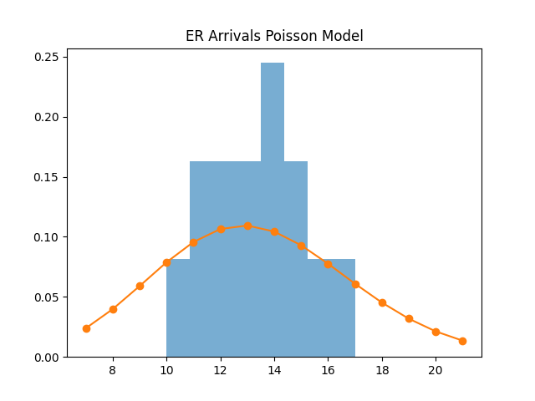
Data vs Poisson Distribution
Notes:
The visualization is used to place the observed data of emergency room arrivals in comparison with the theoretical model of the Poisson distribution. The histogram is the actual patient arrival frequencies, and the Poisson curve is the expected probability with a calculated mean rate. The given comparison can assist in assessing the radicalness of the correspondence between real-world data and theoretical assumptions. Recent research in healthcare modelling indicates that in emergency department forecasting and performance analysis, Poisson processes are widely used as benchmark models (Reboredo et al., 2023). Any observable and predicted value difference that is less than that is because of some randomness and external variations like seasonal illness or accidents. Nevertheless, a good fit suggests that the Poisson model is an acceptable approximation to actual ER arrival behavior. This type of visualization aids in decision-making as it helps the hospital administrators to estimate the patterns of demand and variability. It also explains the significance of statistical modeling in healthcare planning and resource allocation.

Slide 7
Mean Rate (λ) Calculation
Total observations: 14 days
Sum of values: 187
Mean (λ): 13.36
Represents average arrivals per day
Notes:
The average mean (λ) of the emergency room arrivals per day is a significant parameter of the Poisson distribution. It is estimated by dividing the total number of arrivals seen by the number of days of the data. This value is used to describe the central tendency of the patient inflow, and it is used to estimate probability. Recent research on hospital forecasting highlights that, to optimize the staffing and resources used in the emergency departments, it is important to estimate the number of people arriving in the hospitals with due accuracy (Rostami-Tabar et al., 2024). A constant λ indicates consistent behavior of the system, and the variances could reflect dynamism in changes in demand. In this dataset, λ is calculated based on 14 days of data, which is a good estimate of the average demand. This parameter is subsequently converted to a Poisson probability model and generates anticipated distributions. It is essential to know about λ to effectively utilize the model in a real healthcare environment.

Slide 8
Interpretation of Results
Data approximates Poisson behavior
Small fluctuations are expected
No strong outliers observed
Model fits moderate accuracy
Useful for predictive planning
Notes:
The results are interpreted in terms of the Poisson distribution being a good fit to the observed data in the emergency room. The analysis reveals that the dataset is more or less of a Poisson pattern with some deviations caused by randomness and real-world complexities. These variations are anticipated in health care settings, whereby the influx of patients is affected by the unpredictability of such factors as accidents or seasonal diseases. According to recent literature, Poisson models can give quite decent baseline forecasting performance; however, the reality has been found to demand extensions, e.g., time-varying or nonhomogeneous versions of the Poisson process, in order to achieve better forecasting (Rostami-Tabar et al., 2024). The model is still applicable even with its constraints to determine the general trends and contribute to operational planning. The derivation proves that the Poisson model is suitable for estimating average demand variability in ER. This assists hospitals in becoming better prepared and minimizing the risks of overcrowding by implementing more effective staffing practices.

Slide 9
Conclusion
Poisson distribution models event counts
Useful in healthcare planning
ER arrivals follow random pattern
Supports staffing decisions
Helps improve resource allocation
Notes:
Poisson distribution is a useful statistical model that can be used to represent emergency room patient arrivals and other systems that are based on the occurrence of an event randomly. This paper illustrates how the model can be used through 14 days of real data and how the model can be used to approximate the observed pattern. The findings verify that the ER arrivals are reasonable to be assumed as a Poisson process with a mean rate λ calculated. Current studies in healthcare reinforce the further application of Poisson-based models in predicting and operational planning of hospitals. In spite of the fact that real-world data may have fluctuations, the model can be helpful in considering staffing and resource allocation. It aids the administrators in foreseeing the demand and enhancing efficiency in emergency departments. On the whole, the Poisson distribution is considered one of the cornerstones of statistical modeling and healthcare analytics since it provides a straightforward yet effective model to understand random arrivals in a complicated system.

Slide 10
References
Bell, L., & Wagner, R. (2019). Modeling Emergency Room Arrivals Using the Poisson Process. The College Mathematics Journal, 50(5), 343–350. https://doi.org/10.1080/07468342.2019.1662710
Jiang, S., Liu, Q., & Ding, B. (2023). A systematic review of the modelling of patient arrivals in emergency departments. Quantitative Imaging in Medicine and Surgery, 13(3), 1957–1971. https://doi.org/10.21037/qims-22-268
Reboredo, J. C., Barba-Queiruga, J. R., Ojea-Ferreiro, J., & Reyes-Santias, F. (2023). Forecasting emergency department arrivals using INGARCH models. Health Economics Review, 13(1), 51. https://doi.org/10.1186/s13561-023-00456-5
Rostami-Tabar, B., Browell, J., & Svetunkov, I. (2024). Probabilistic forecasting of hourly emergency department arrivals. Health Systems, 13(2), 133–149. https://doi.org/10.1080/20476965.2023.2200526

